Slide 1
Connection Lab Final Project: An ASL Translator of Sorts...
By. Chris Wray

Slide 2
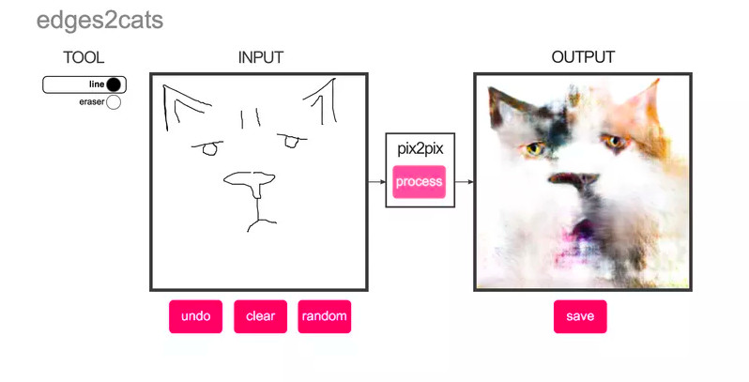
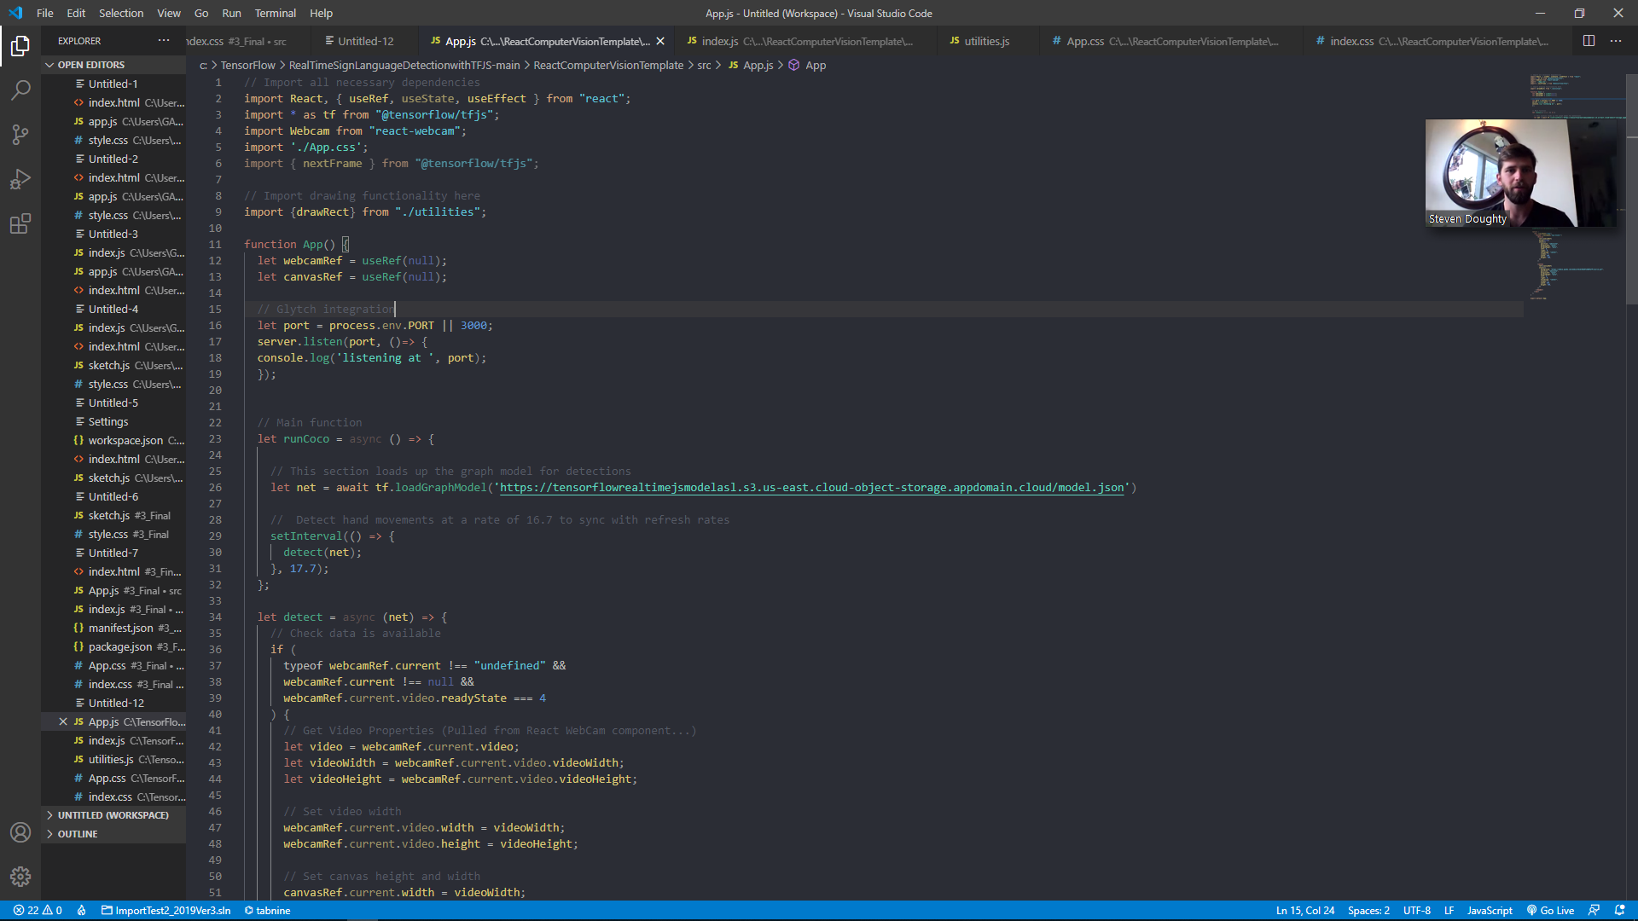
Motivation:
To provide an application of use to an underserved group.
To dive into AI training and learn TensorFlow at the same time.
To work with datasets that can be translated into AI models.
To learn what the pain points are when working with AI models.
To hopefully inform my other projects.

Slide 3
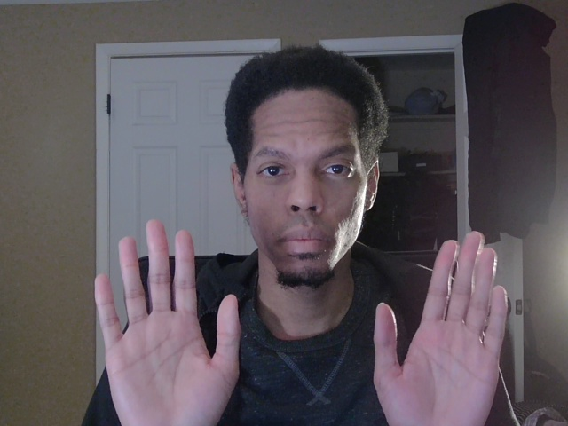
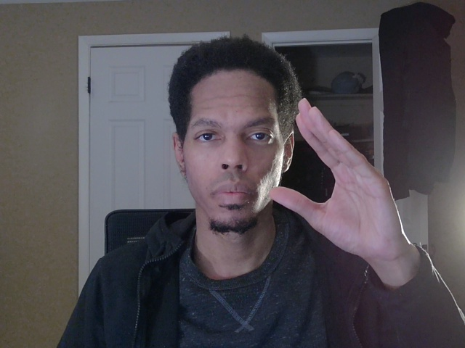
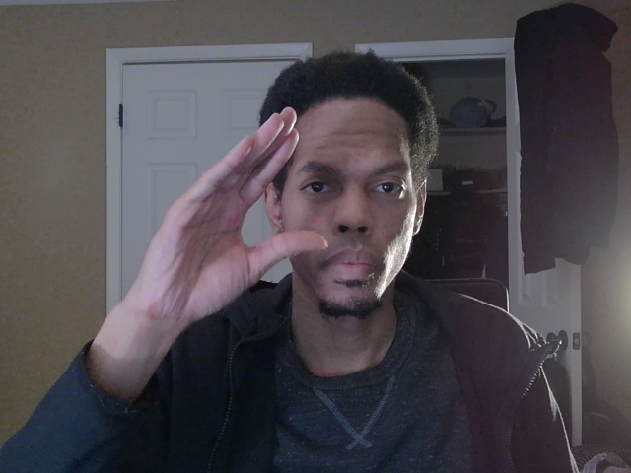
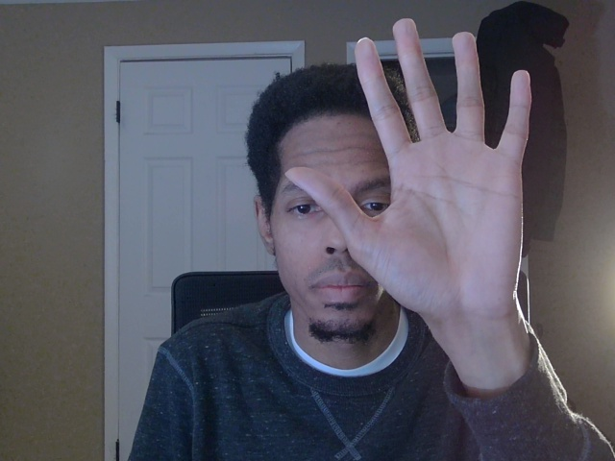
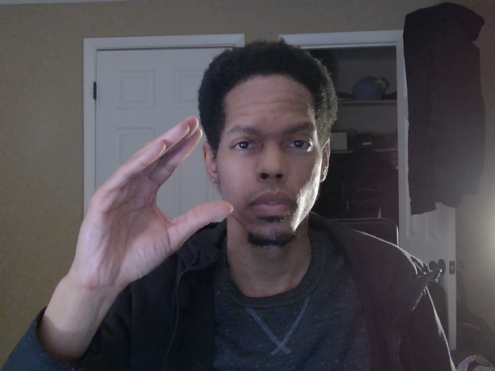
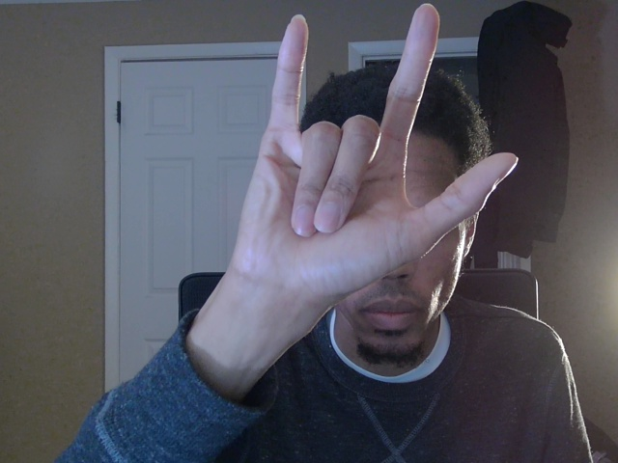
Context:
It seems like ASL users are particularly under served, and AI seems perfect to open up that, and many more niche communities to ease of access.
It could also be used to translate from ASL to regional Sign Language with a bigger db.
No one talks about reaching to differently bodied people without a large $$$ motive.

Slide 4
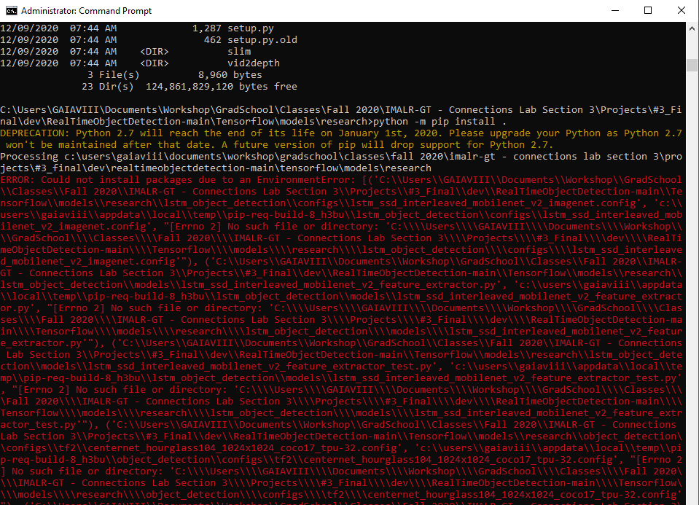
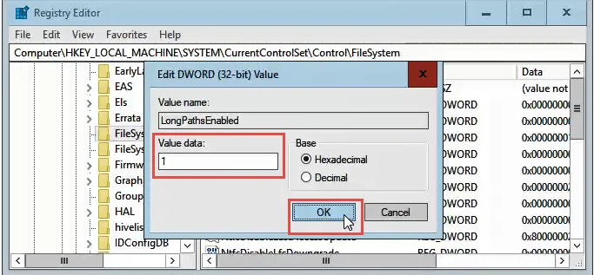
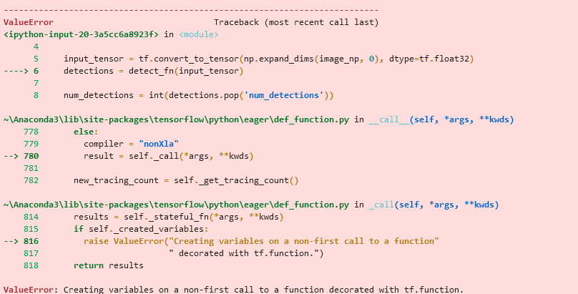
Key Challenges:
“Crunchy” environment issues...
Language Differences:
Certain words do not exist in ASL and/or are implied.
Some signs are concatenated and represent
Wiping motions prove to be very troublesome to capture.
Too many AI Examples!
Easy to get lost in the weeds...
Constant “FileTooLong” errors...
React has not helped smooth things along either…

Slide 5
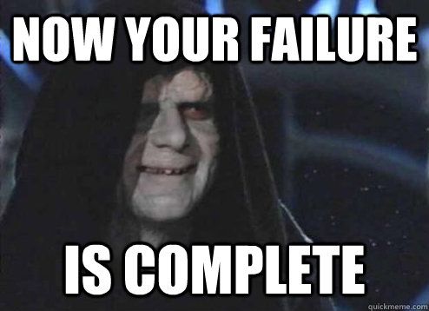
Next Steps:
Troubleshoot the visual element issues…
Can’t see AI elements even though they are coded in right now and should appear.
WebGL issue
Add/Fix missing/hidden visual elements.
Find way to poll video for AI database as opposed to pictures.
Create a gold VM image to make the dev process go smoothly.

